Slide 1
Data smoothing
R function
Review and discussion

Slide 2
Data smoothing

Slide 4
Applications
Remove noisy data points
Detect trends in the noisy data
Predict trends or patterns
Temporal interpolation
….
http://tester01.dfci.harvard.edu/dsbook/smoothing.html

Slide 5
http://tester01.dfci.harvard.edu/dsbook/smoothing.html
Smoothing techniques:
Bin smoothing
Kernel smoothing
Week7 demo (wee7_2.R)

Slide 6
Data smoothing
R function
Review and discussion

Slide 7
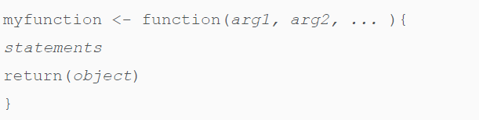
R function
function name
Built-in Function
Simple examples of in-built functions are seq(), mean(), max(), sum(x) paste(...)
User-defined Function

Slide 8
Why R function
Automate common tasks in a more general way than copy-and-pasting
Reduce incidental mistakes
Easy to update
..

Slide 9
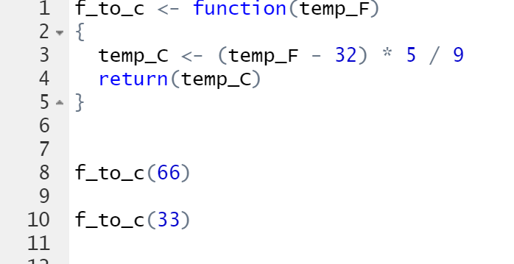
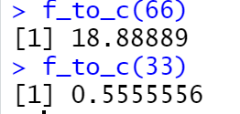
Example: fahrenheit to Celsius conversion
f_to_c <- function(temp_F)
{
temp_C <- (temp_F - 32) * 5 / 9
return(temp_C)
}
Include the R function in your main script

Slide 10
Another approach to call the function:
Save the above function as “f_to_c.R”
In your main rscript, you may include:
source(‘f_to_c.R’)
as one line of script, just like library(raster),
then you can call the function by using:
t<-f_to_c(100)

Slide 11
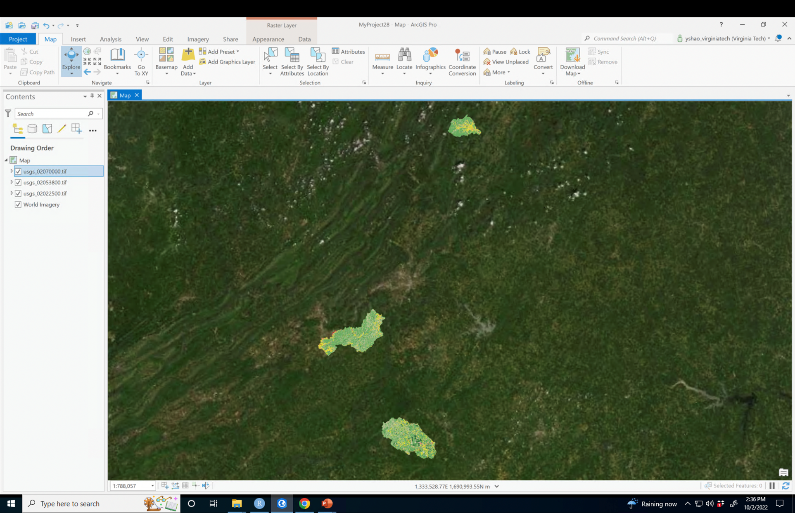
R function for a geospatial problem
Calculate %forest for watersheds (id=usgs_0207000; usgs_02053800; usgs_02022500)

Slide 12
Arguments
p_forest <- function(‘usgsid’)
{
}
Output – please print %forest for any user-defined usgs_id (or raster file name)

Slide 13
R programming (review)

Slide 14
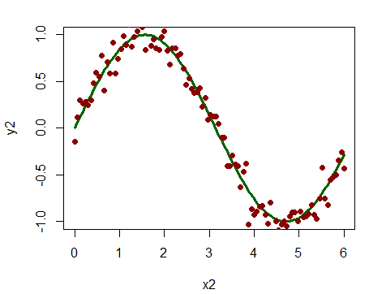
week1
General course introduction
Rstudio (software installation; Library)
Data types and plots in R

Slide 15
week2
Raster and rgdal packages
readOGR()
raster()
SpatialpolygonDataFrame (similar to shapefile in ArcGIS)
Raster

Slide 16
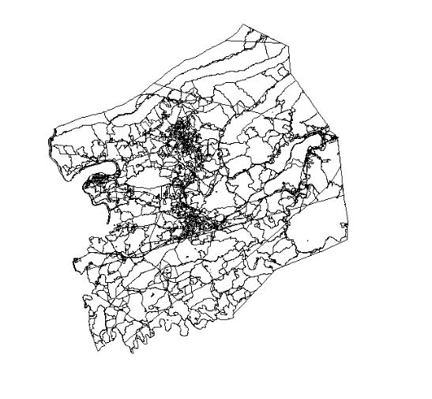
week2
Handling spatial data in R
crs()
spTransform()
projectRaster()
mapview()
Field calculator, select by attributes, select by location, summary statistics
pophu_p$area<-gArea(pophu_p,byid=T)
pophu_p[pophu_p$POP10>1000,]
intersect(pophu_p, county)
….

Slide 17
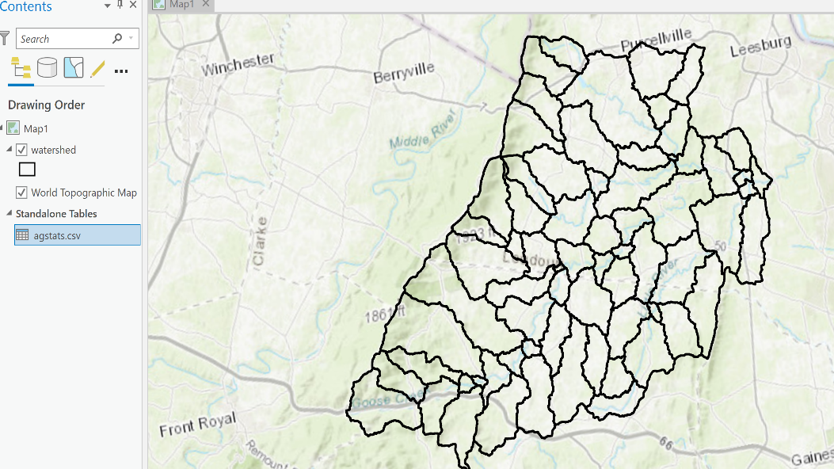
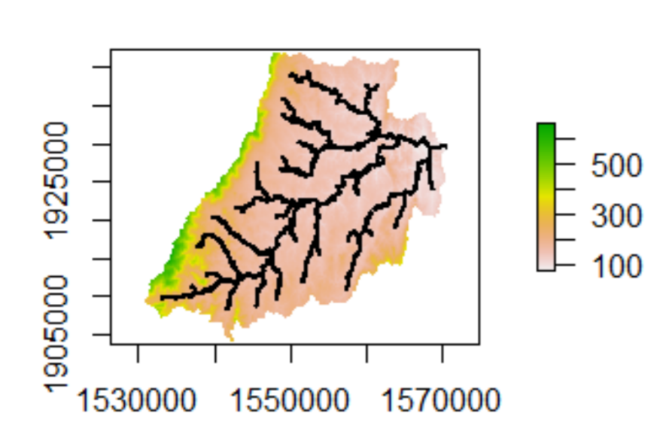
week3
dplyr and spdplyr libraries
Join tables
Buffer (shapefile), unionSpatialPolygons
Zonal statistics as table (for Raster data)
iris %>% filter(Species=='setosa',Sepal.Length>5.0) %>% select(Species,Sepal.Length)

Slide 18
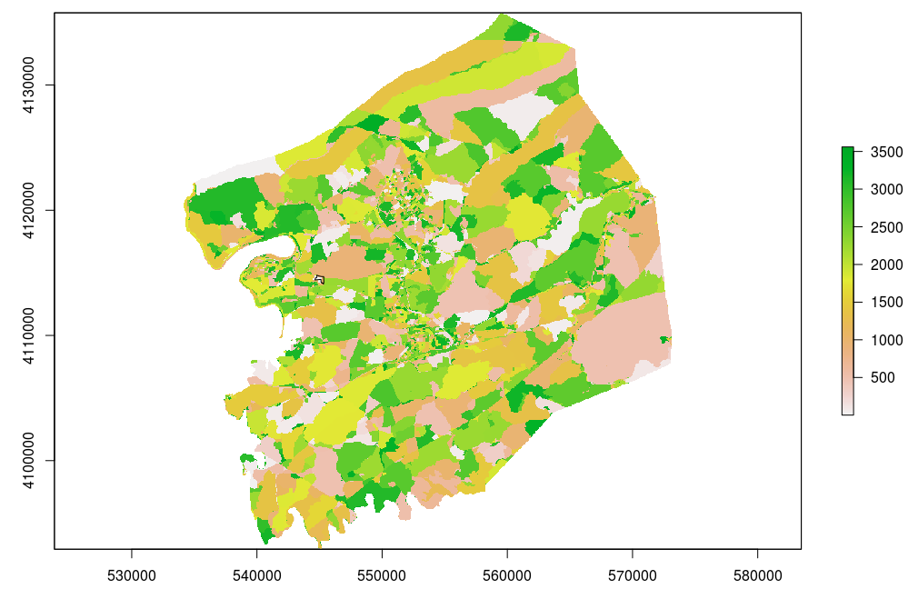
week3
merge(a,b,by=‘Subbasin')
buffer(stream,150)
unionSpatialPolygons()
rasterize(pophu_p, dem, field = pophu_p$newid)
zonal()

Slide 19
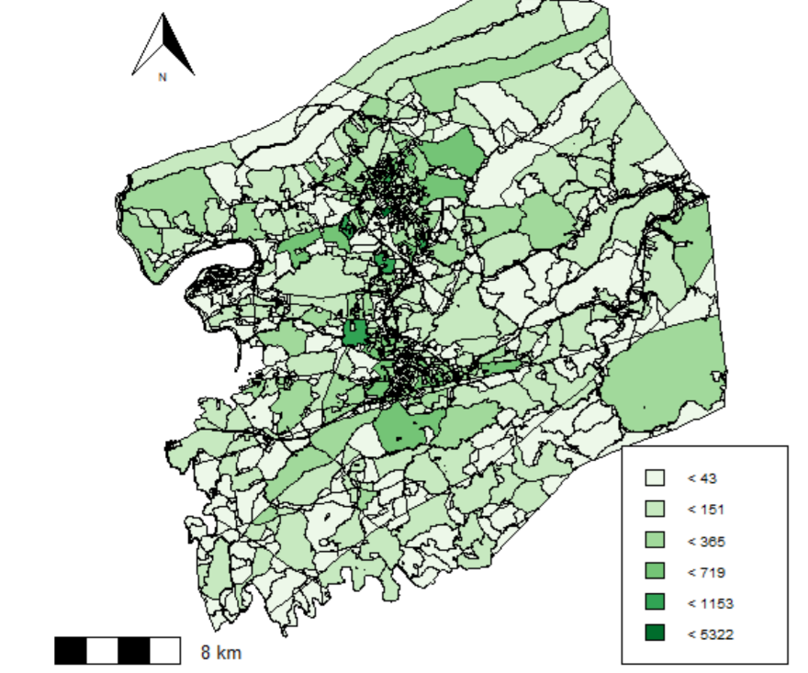
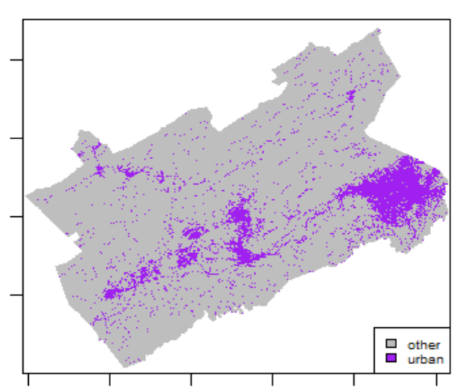
week4
mapview(roads)
Create maps in R
library(prettymapr)
addnortharrow()
addscalebar()
library(RColorBrewer)
library(classInt)
m<-c(1, 12, 0,13, 24, 1, 25, 95, 0)
rcl<-matrix(m, ncol=3, byrow = T)
nlcdr<-reclassify(nlcd, rcl = rcl)

Slide 20
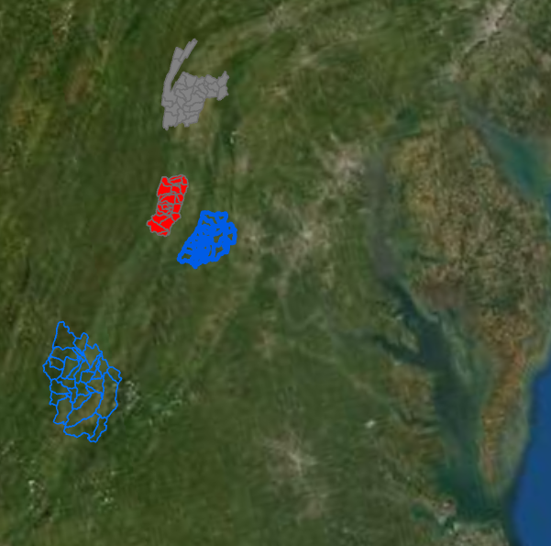
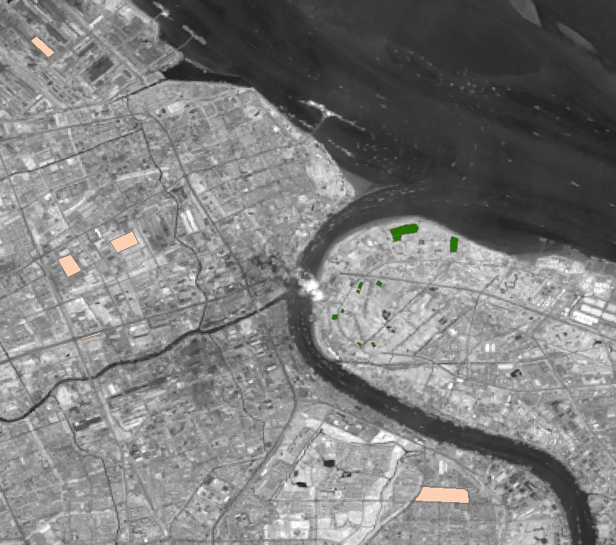
week5
For loop
Generate file names using paste() function
FedData library
Remote sensing image classification
randomforest()
getValues()
setValues()
is.na()

Slide 21
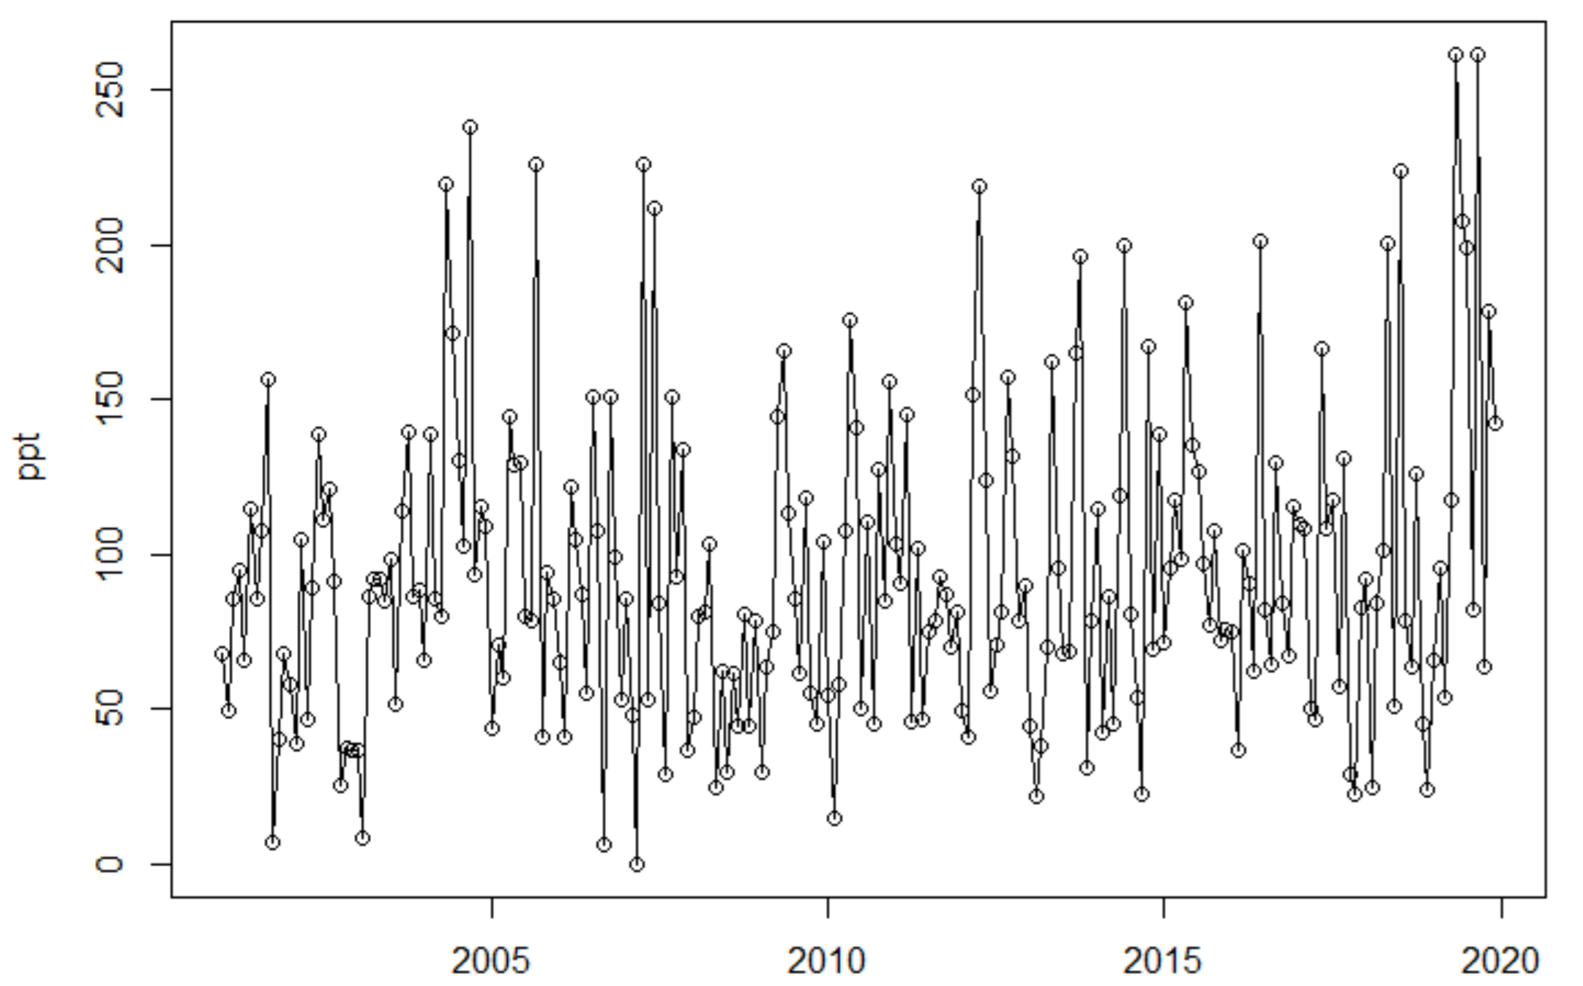
week6
Time-series analysis
Trend analysis (for loop and ifelse statement)
Change detection
lmodel<-lm(ndvi~year,data=df)
library(trend)
sens.slope(ndvi,conf.level = 0.95)

Slide 22
Many useful functions and libraries:
length(), dim(), data.frame(), matrix(), colnames(), hist()
writeOGR()
writeRaster()
calc(rasterstack,fun=mean)
stack()
getValues()
setValues()
read.csv()
write.csv()
Download data:
prism library
rnoaa
FedData (get_ned)
dataRetrieval

Slide 23
In-class

Slide 24
labs
Lab1(software..)
Lab2 (WUI mapping)
Lab3 (Forest fire)
Lab4 (Remote Sensing image classification; caret package)
Lab5 (Time-series data)

